Slide 1


University Database Management System

Slide 2
Content
1) Introduction
2) Data Base Design
3) SQL/PLSQL Implementation
4) Automation Scripts
5) Java Application

Slide 3
Introduction
Brief Overview of the Project:
The University Data Management System is a comprehensive solution designed to streamline and optimize the management of student, doctors, course, department, and grade-related data within the university environment. It encompasses various components such as database design, SQL and PLSQL implementation, automation scripting, Java application development, and integration to ensure efficient data handling and reporting capabilities.

Slide 4
Objectives and Goals:
Designing and implementing a robust relational database schema to store and manage student, doctors, course, department, grades, GPA history information securely.
Developing SQL and PLSQL scripts to facilitate data manipulation tasks and perform complex calculations such as GPA computation.
Implementing automation scripts to automate routine tasks like database backup, disk space monitoring, and anomaly detection for system reliability.
Creating a Java application following OOP principles to interact with the database, enabling CRUD operations and seamless integration.
Generating comprehensive reports within the Java application to provide valuable insights into courses, enrolled students, and average GPA per course.

Slide 5
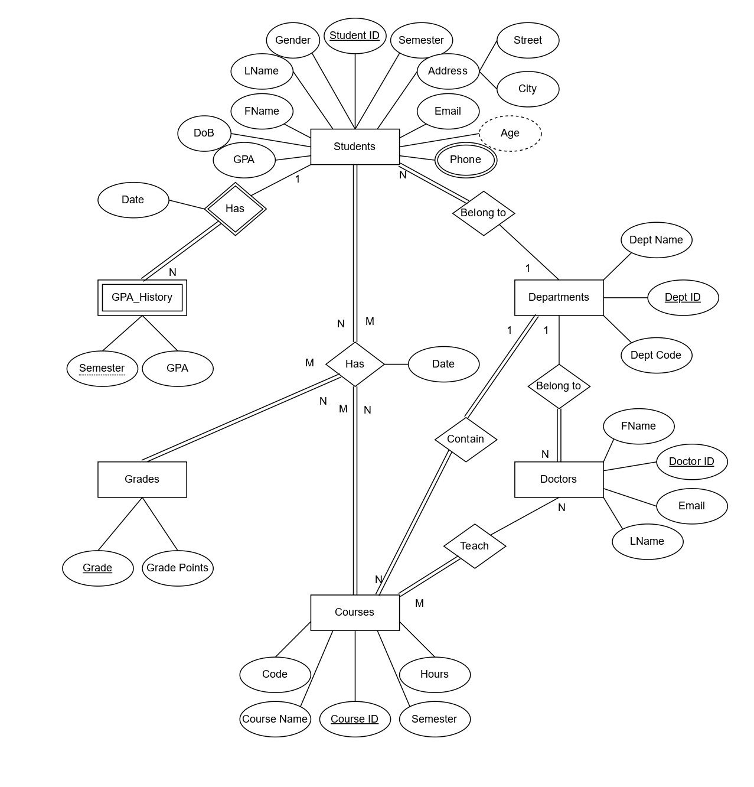
Database Design
Entity Relationship Diagram consist of :
Students.
Doctors.
Courses.
Grades.
Departments.

Slide 6
Database Design
Mapping :
Students : (Student_ID, FName, LName, Email, DoB, Gender, Semester, GPA, City, Street, Dept_ID(FK))
Student_Phone : (Student_ID(FK), Phone)
Departments : (Dept_ID, Dept_Name, Dept_Code)
Courses : (Course_ID, Course_Name, Hours, Course_Code, Semester, Dept_ID(FK))
Doctors : (Doctor_ID, FName, LName, Email, Dept_ID(FK))
Teach : (Doctor_ID(FK), Course_ID(FK))
Grades : (Grade, Grade Points)
Has : (Student_ID(FK), Course_ID(FK), Grade(FK), Date)
GPA_History :(Student_ID(FK), Semester, GPA, Date)

Slide 7
SQL/PLSQL Implementation
Functions :
get_student_id : This function is used to get the student id by his email
get_doctor_id : This function is used to get the doctor id by his email
get_course_id : This function is used to get the course id by its code
get_department_id : This function is used to get the department id by its code
calc_course_avg_gpa : This function is used to calculate the Average grades or gpa of the course for all students that enrolled in this course.
calc_gpa : This function is used to calculate the CGPA of the student.
Triggers :
insert_gpa_history : This trigger used to add student_id, semester, grade, and date into gpa_history table when the information of student updated and move to next semester.

Slide 8
SQL/PLSQL Implementation
Procedures:
insert_student_info : This procedure used to insert the students information except phones information into students table.
insert_student_phones : This procedure used to insert the student’s phones information into student_phones table.
insert_doctor_info : This procedure used to insert the doctors information into doctors table.
insert_course_info : This procedure used to insert the courses information into courses table.
insert_department_info : This procedure used to insert the departments information into departments table.
insert_take : This procedure used to insert the student id, course id, and date into has table.
Insert_has : This procedure used to update the grade of the student to a specific course into has table.

Slide 9
SQL/PLSQL Implementation
Insert_teach : This procedure used to insert the doctor_id, and course_id into teach table.
Upd_student_info : This procedure used to update the student informations.
Upd_course_info : This procedure used to update the course informations.
delete_student : This procedure used to delete the students information from students table and all other tables that have data related to that student.
delete_doctor : This procedure used to delete the doctors information from doctors table and all other tables that have data related to that doctor.
delete_course : This procedure used to delete the courses information from courses table and all other tables that have data related to that course.
delete_teach : This procedure used to delete the doctor_id and course_id from teach table.
delete_department : This procedure used to delete the departments information from departments table if there is no related data with this department and any other tables.

Slide 10
Automation Scripts
Database Backup Bash Script:
This bash script is designed to perform a database backup using the expdp utility. It generates a unique name for the backup file based on the current date and time.
Disk Space Monitoring Bash Script:
This bash script monitors disk space usage on the system.
System Anomaly Detection Bash Script:
This bash script detects anomalies related to CPU usage, RAM usage, and disk space availability on the system. And using task scheduler to run this script daily

Slide 11
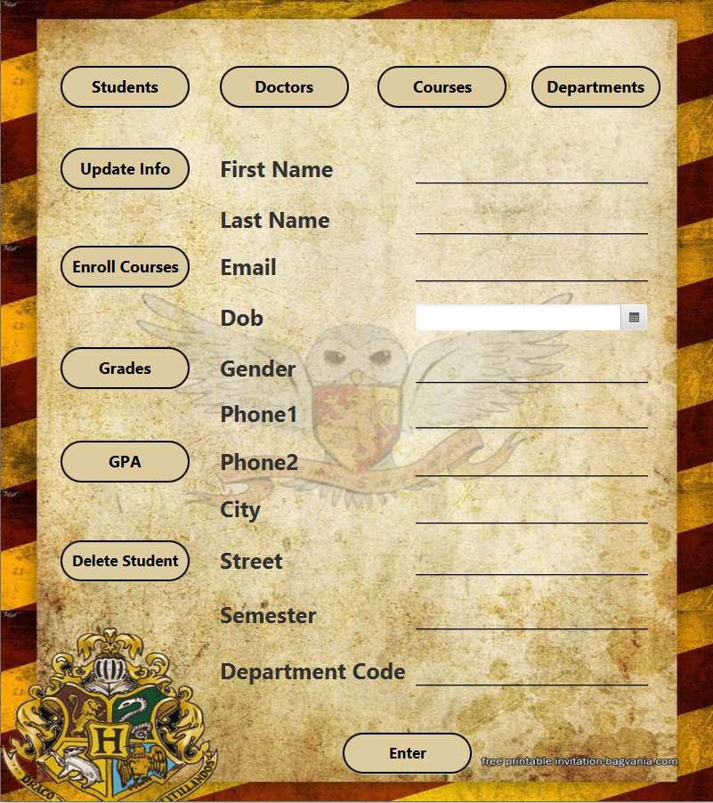
Java Application
Divided into 4 main Scenes
Students Scenes:
The first scene in it is the insert scene, also have 4 buttons to move between main scenes, and another 5 buttons to update student info, enroll courses, set courses grades, calculate CGPA and semester GPA, and delete student

Slide 12
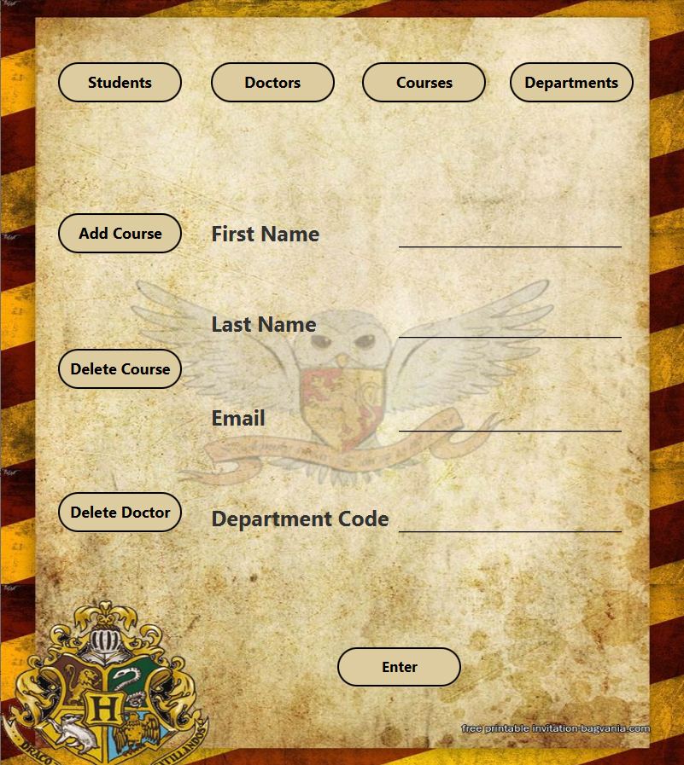
Java Application
Doctors Scenes:
The first scene in it is the insert scene, also have 4 buttons to move between main scenes, and another 3 buttons to assign courses to doctor, remove assigned courses from doctor, and delete doctor

Slide 13
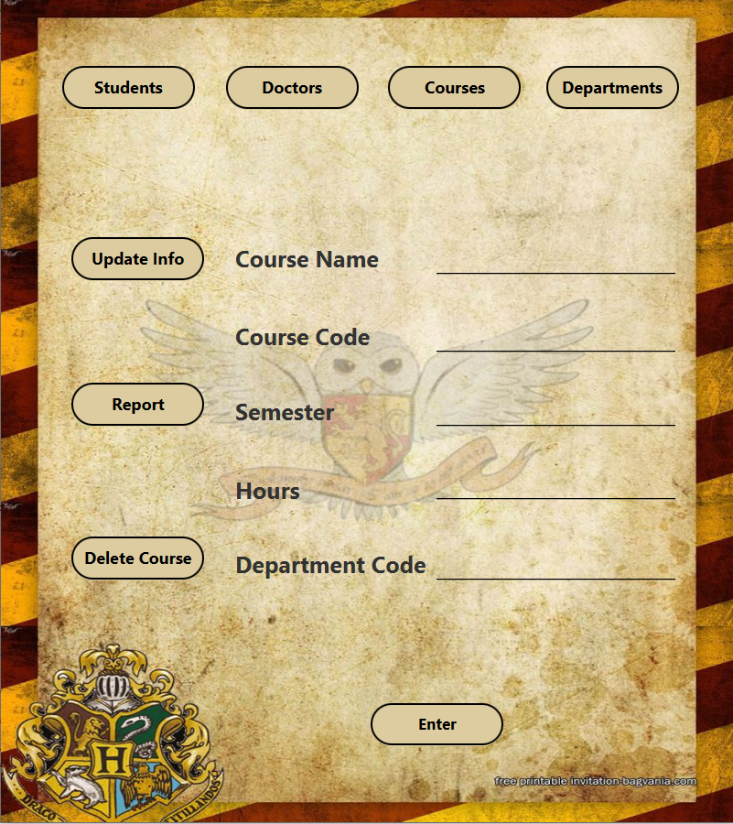
Java Application
Courses Scenes:
The first scene in it is the insert scene, also have 4 buttons to move between main scenes, and another 3 buttons to update course info, generate a report to see the enrolled students in this course with the average GPA of this course, and delete course

Slide 14
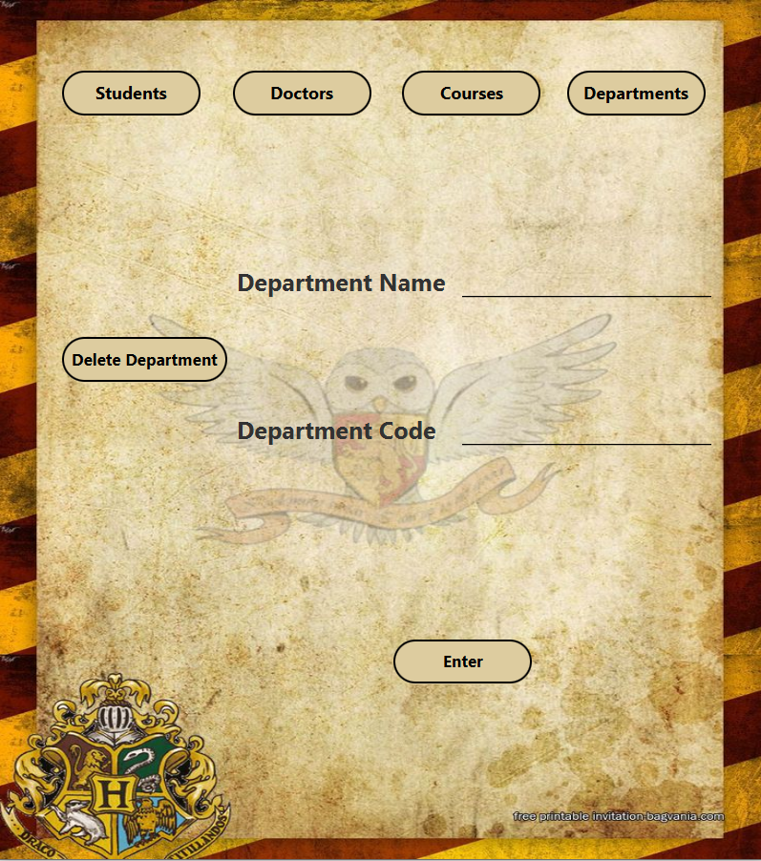
Java Application
Departments Scenes:
The first scene in it is the insert scene, also have 4 buttons to move between main scenes, and another 1 button to delete department

Slide 15
Thanks

